Slide 1
Student Data Analysis

Slide 2
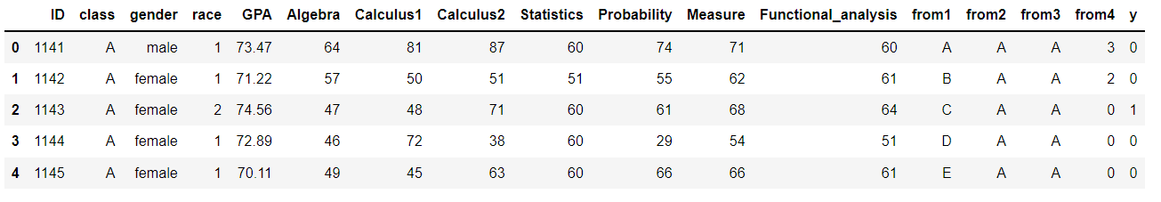
Reading the data:

Slide 3
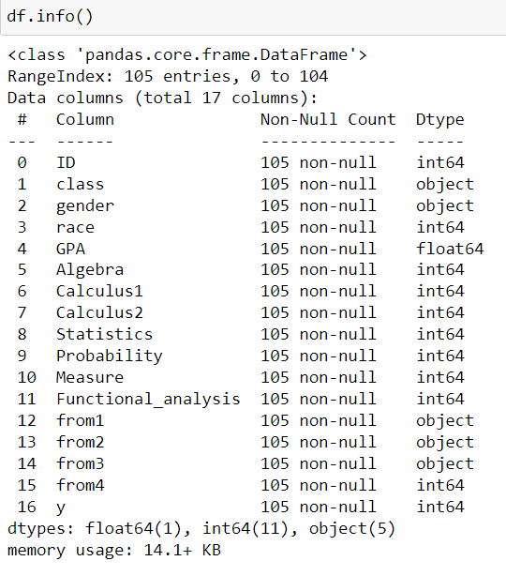
Info of data:

Slide 4
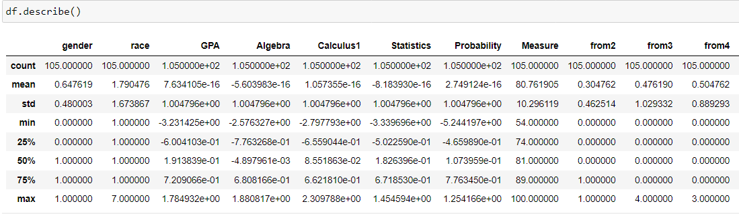
Statistical summary:

Slide 5
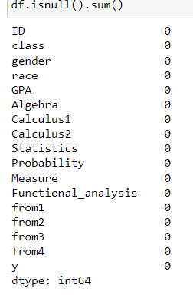
Null values:

Slide 6
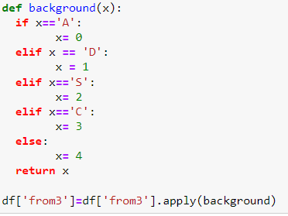
Replace Letter into numeric:

Slide 7
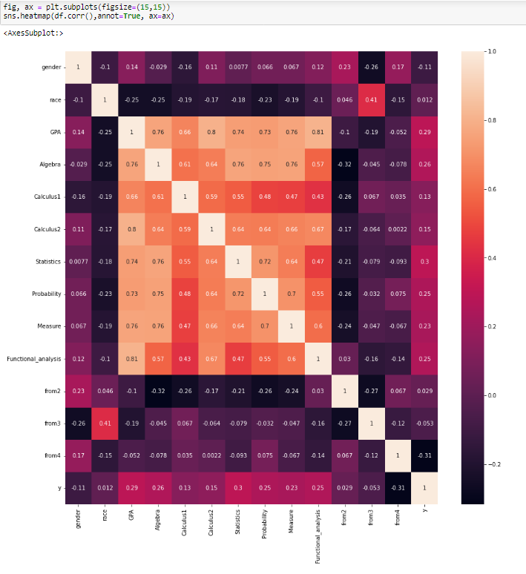

Slide 8
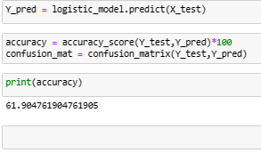
Model:

Slide 9
THANK YOU!!

